Slide 1
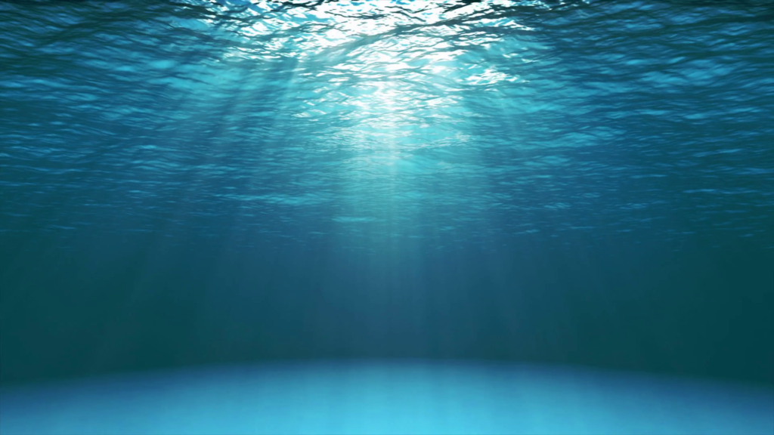
Underwater Backscatter Networking
Junsu Jang, Fadel Adib
MIT Media Lab
ACM SIGCOMM 2019
Presented by Team 1, InYong Koo
Notes:
The authors from Carnegie Mellon University (카네기 멜론대학교)

Slide 2
Remember this?
I will directly quote authors’ words in following manner:
I will state my thoughts in following manner:
If I struggle, please help me out :)
“We present Piezo-Acoustic Backscatter (PAB),
a system that enables underwater networking at near-zero power.”
Piezo? THE piezo we used on PA2? I thought it was a simple buzzer..
Piezo? THE piezo we used on PA2? I thought it was a simple buzzer..
Notes:
Before we dive in to the paper, Let me give you some

Slide 3
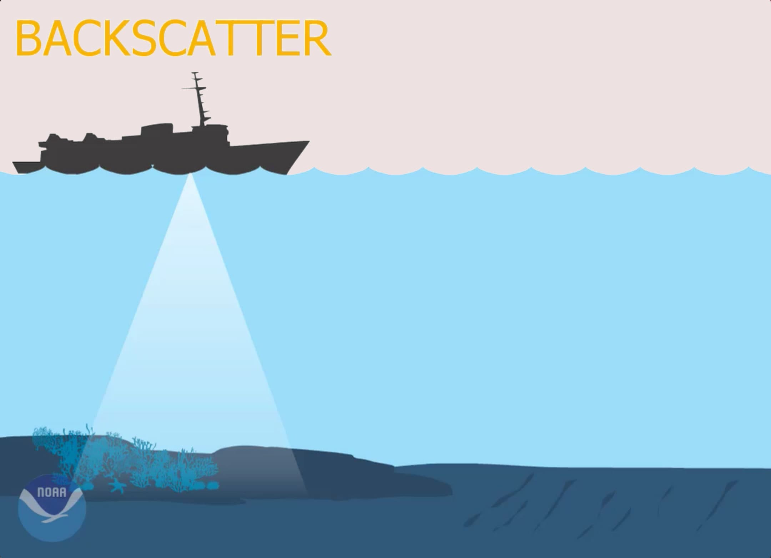
Objective
Backscatter?
Underwater Backscatter Networking
“Backscatter is the lowest power
wireless communication technology”
- Simply reflects radio signals in the environment
- Widespread adaption for ultra-low power networking
- However, radio signals die exponentially in water
The paper is not about networking underwater backscatter,
It’s about enabling backscatter networking underwater.
SONAR-based imaging of objects by reflection
Notes:
Our paper title is Deus EM Machina: On-Touch contextual functionality for smart IoT Appliances. Does anybody knows what IoT stands for?
Definition
a system of interrelated computing devices, mechanical and digital machines, objects, animals or people that are provided with unique identifiers (UIDs) and the ability to transfer data over a network without requiring human interaction.
To me, IoT gives an idea of smart home, where you can control all the appliances by your phone. From TV, lights, refrigerators, internet router, and thermostats. It enriches human-computer interaction.

Slide 4
Expectations
“Backscatter technology would eliminate the need for batteries”
- Smaller size, lower cost, no need for frequent replacement
Climate change
Naval deployments
Marine animals
Battery-free
Underwater
Sensors
Oil spill monitoring
Space missions
Notes:
Our paper title is Deus EM Machina: On-Touch contextual functionality for smart IoT Appliances. Does anybody knows what IoT stands for?
Definition
a system of interrelated computing devices, mechanical and digital machines, objects, animals or people that are provided with unique identifiers (UIDs) and the ability to transfer data over a network without requiring human interaction.
To me, IoT gives an idea of smart home, where you can control all the appliances by your phone. From TV, lights, refrigerators, internet router, and thermostats. It enriches human-computer interaction.

Slide 5
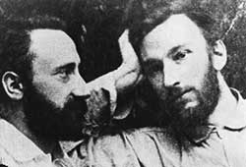
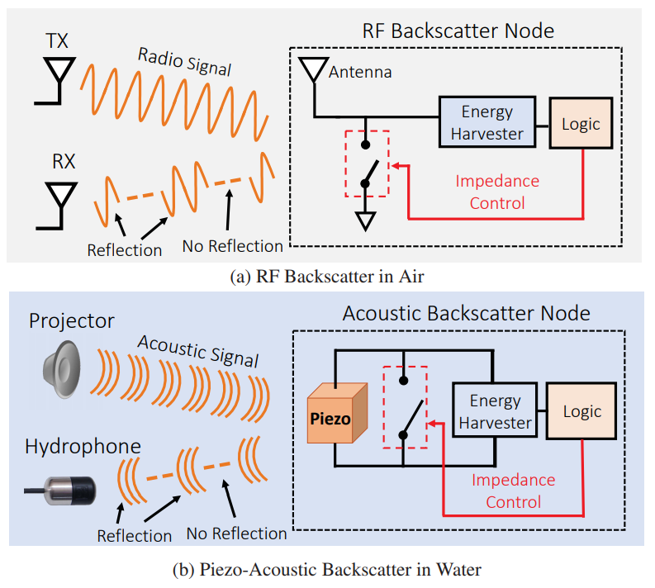
Principle
Greek word Piezein: to squeeze or press
Used acoustic signals
instead of radio signals
Piezoelectric Effect (1880)
압전효과
Jacques (left) and Pierre (right) Curie
Certain types of crystals generate an electric charge when they undergo a mechanical strain (deformation).
Mechanical Electrical
Notes:
Dielectric polarization

Slide 6
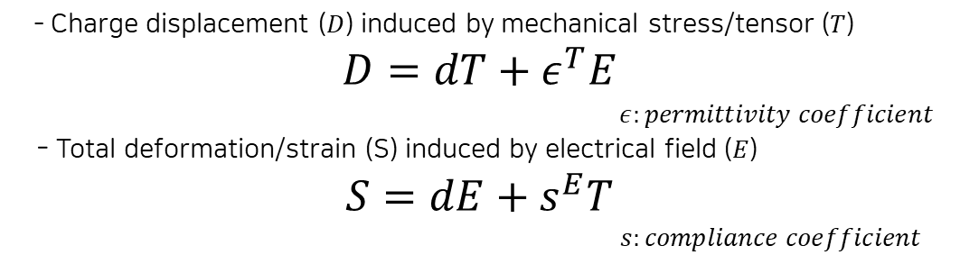
Principle
Greek word Piezein: to squeeze or press
Used acoustic signals
instead of radio signals
Piezoelectric Effect (1880)
압전효과
- Charge displacement ($D$) induced by mechanical stress/tensor ($T$)
$$D=dT+ε^{T}E$$
$ε:permittivity coefficient$
- Total deformation/strain (S) induced by electrical field ($E$)
$$S=dE+s^{E}T$$
$s:compliance coefficient$
Jacques (left) and Pierre (right) Curie
Certain types of crystals generate an electric charge when they undergo a mechanical strain (deformation).
Mechanical Electrical
Notes:
Dielectric polarization

Slide 7

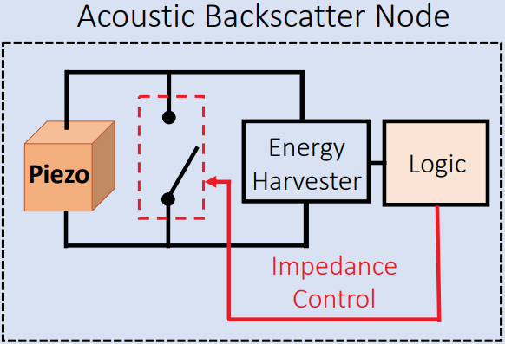
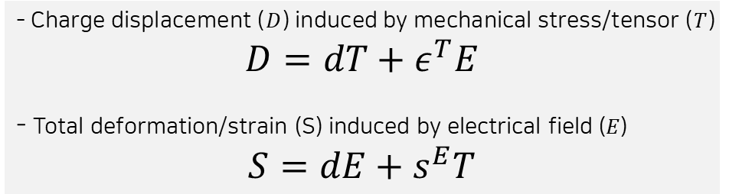
Backscatter via Piezo
= Reflective state, 1
Switch closed
Circuit around piezo is shorted
(dE=0)
D = 0, E = 0
dT = 0
S = sT
incident = reflected
No deformation
dS = s dT = 0
- Charge displacement ($D$) induced by mechanical stress/tensor ($T$)
$$D=dT+ε^{T}E$$
- Total deformation/strain (S) induced by electrical field ($E$)
$$S=dE+s^{E}T$$
“PAB transforms the piezoelectric material into a reflector by preventing it from deforming.”
Notes:
Dielectric polarization

Slide 8
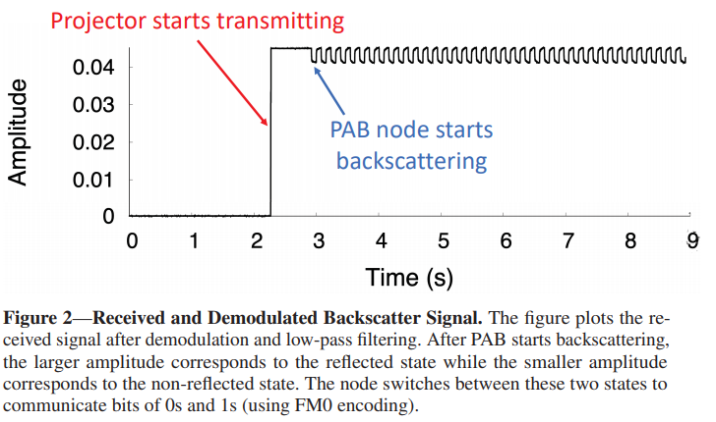
Backscatter via Piezo
= Non-reflective state, 0
Switch opened
Power for ‘1’ state
Power for ‘0’ state
PAB absorbs incident signal
(And harvest energy from it)
Notes:
Dielectric polarization

Slide 9
Principle
= Non-reflective state, 0
Switch opened
Power for ‘1’ state
Power for ‘0’ state
How can we maximize Signal-to-Noise Ratio (SNR)?
We can’t increase power of ‘1’ state...
“To maximize the SNR,
we need to minimize the reflected power in the absorptive state”
PAB absorbs incident signal
(And harvest energy from it)
Notes:
Dielectric polarization

Slide 10
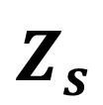

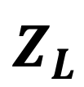

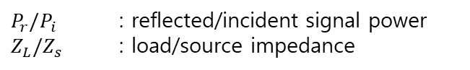
Impedance Matching
Standard backscatter reflection equation
$$P_{r}={\left|\frac{Z_{L}−Z_{s}^{∗}}{Z_{L}+Z_{s}}\right|}^{2}P_{i}$$
$$Z_{s}$$
$$Z_{L}$$
$P_{r}/P_{i}$ : reflected/incident signal power
$Z_{L}/Z_{s}$ : load/source impedance
Match $Z_{L}=Z_{s}^{∗}$!
“the impedance Z(f) itself is a function of frequency”
We can shift resonance frequency by modulating impedance
Notes:
Dielectric polarization

Slide 11
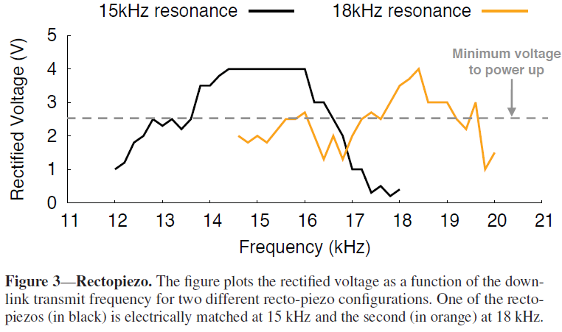
Recto-piezo
“these sensors can operate concurrently while occupying different frequency channels”
We can shift resonance frequency by modulating impedance
Notes:
Dielectric polarization

Slide 12
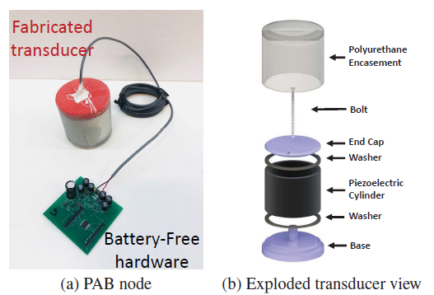
Implementation
What happens here?
Design goal
Switch modes
Match Impedance
Harvest energy
Notes:
Dielectric polarization

Slide 13
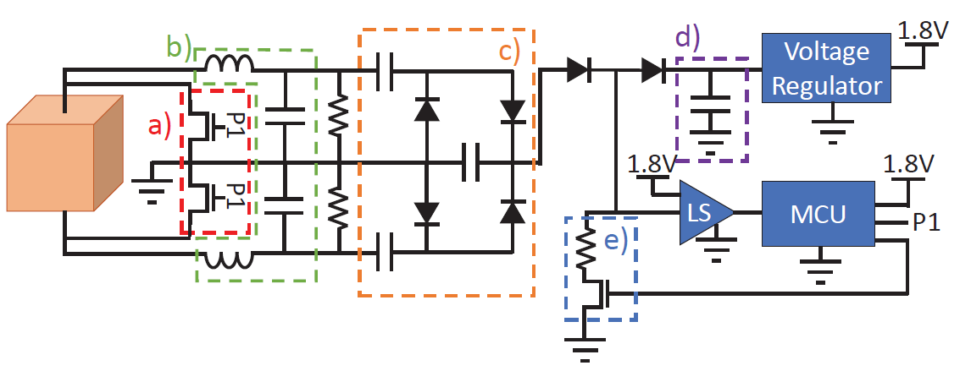
Implementation
Design goal
Switch modes
Match Impedance
Harvest energy
I major in EE ;)
Notes:
Dielectric polarization

Slide 14
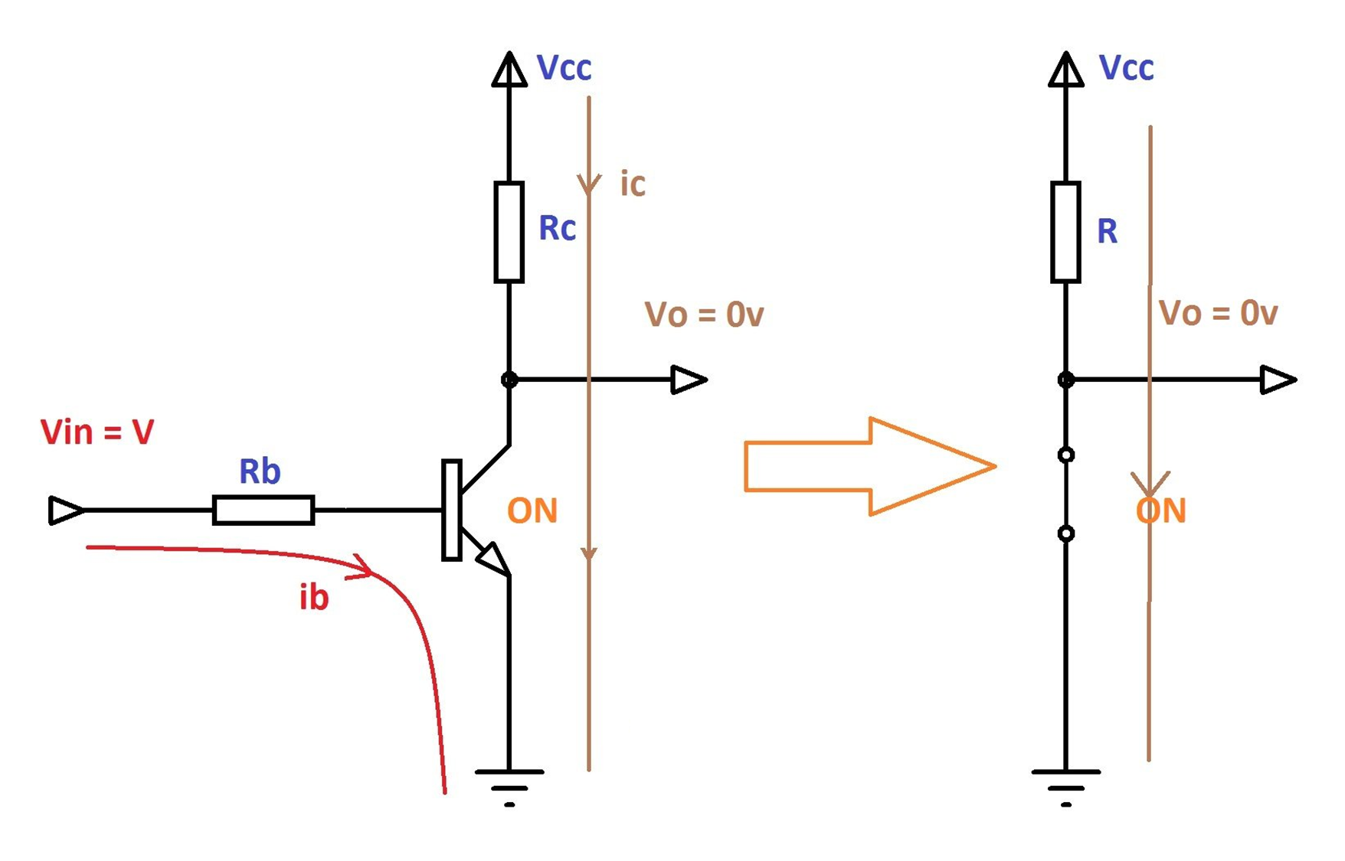
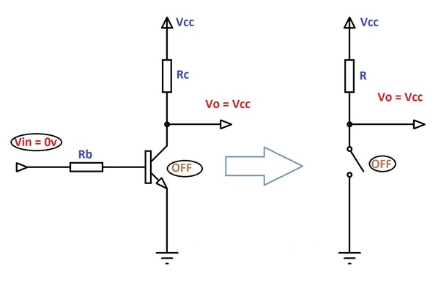
Circuit Intuition
A transistor work as a switch
Design goal
(a)
Switch modes
Match Impedance
Harvest energy
Notes:
Dielectric polarization

Slide 15
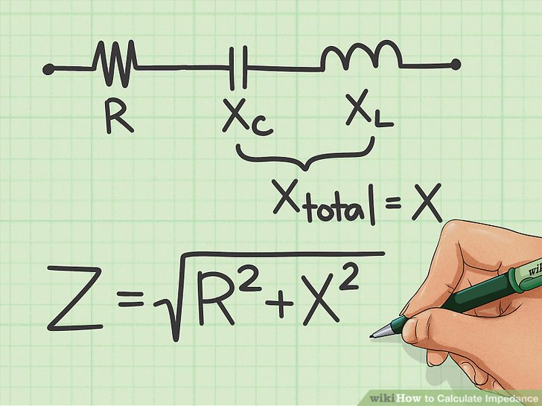
Circuit Intuition
Match Impedance by modulating Reactance
Design goal
(a)
Switch modes
Match Impedance
Harvest energy
(b)
Notes:
Dielectric polarization

Slide 16
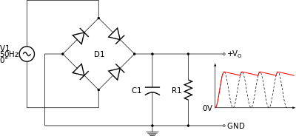
Circuit Intuition
Rectifier converts AC to DC
Design goal
(a)
Switch modes
Match Impedance
Harvest energy
(b)
Notes:
Dielectric polarization

Slide 17
Circuit Intuition
Capacitor stores energy
Design goal
(a)
Switch modes
Match Impedance
Harvest energy
(b)
Notes:
Dielectric polarization

Slide 18
Circuit Intuition
Capacitor stores energy
Design goal
Pull-down transistor regulates current flow
(a)
Switch modes
Match Impedance
Harvest energy
(b)
(d) (e)
Notes:
Dielectric polarization

Slide 19
Circuit Intuition
Design goal
Scale voltage level / Analog to Digital
(a)
LS work as level shifter / Schmitt trigger
MCU is microcontroller unit
Switch modes
Match Impedance
Harvest energy
(b)
(d) (e)
a.k.a. processor
Notes:
Dielectric polarization

Slide 20
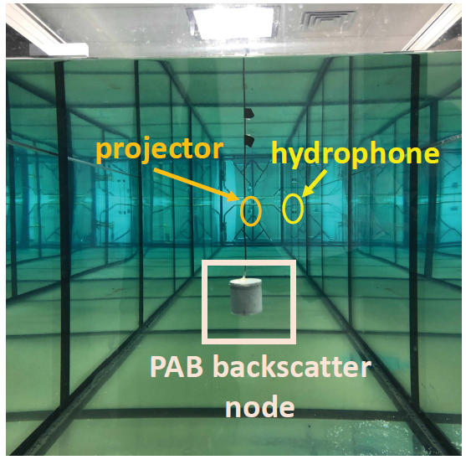
Evaluation
Transmitter
Receiver
Notes:
Dielectric polarization

Slide 21
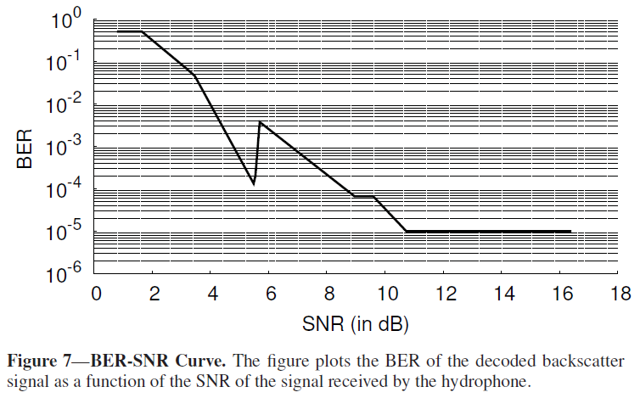
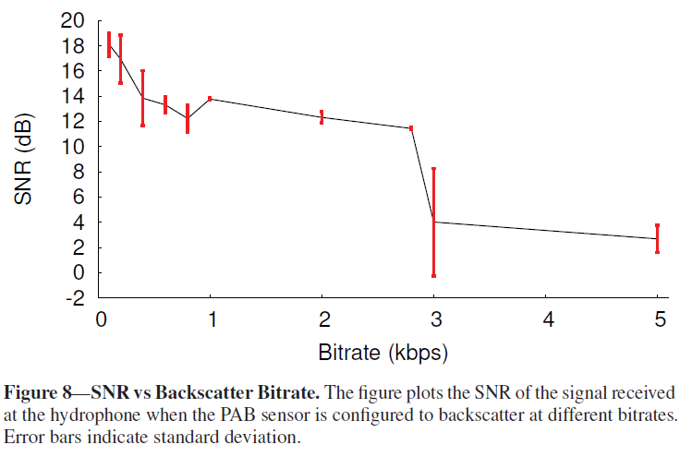
Evaluation
Communication Performance
Bit Error Rate (BER) drops to 10⁻⁵ at SNRs higher than 11dB
Throughput over 3kbps results high BER
Notes:
Dielectric polarization

Slide 22
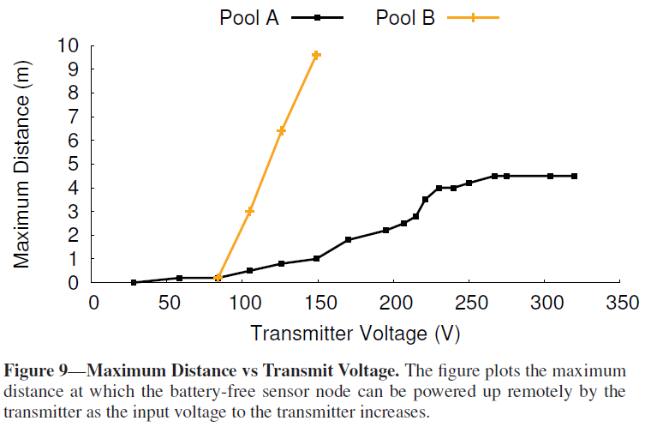
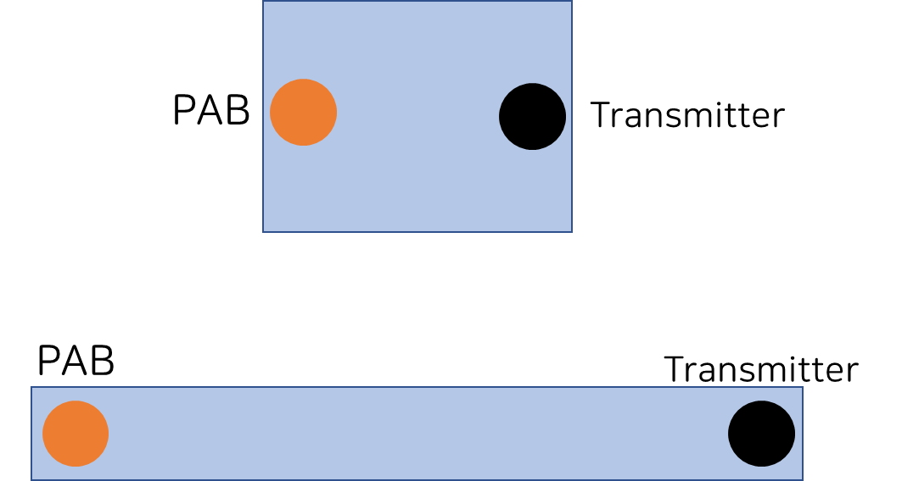
Evaluation
Performance vs Distance
Pool A 3m x 4m (depth 1.3m)
Pool B 1.2m x 10m (depth 1m)
“Pool B is elongated and acts as a corridor, focusing the projector’s signal directionally.”
Notes:
Dielectric polarization

Slide 23
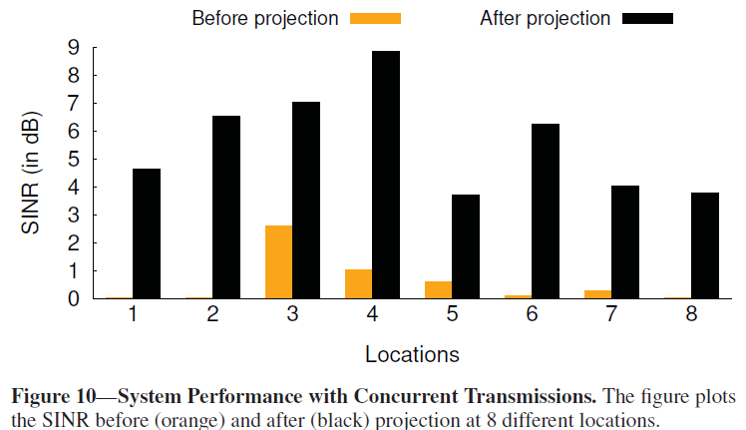
Evaluation
Concurrent Backscatter Transmissions
SINR: Signal-to-Interference-and-Noise Ratio
Concurrent backscatter transmissions interfere even though they’re in different frequency channel.
SINR can be boosted by zero-forcing via projection.
Notes:
Dielectric polarization

Slide 24
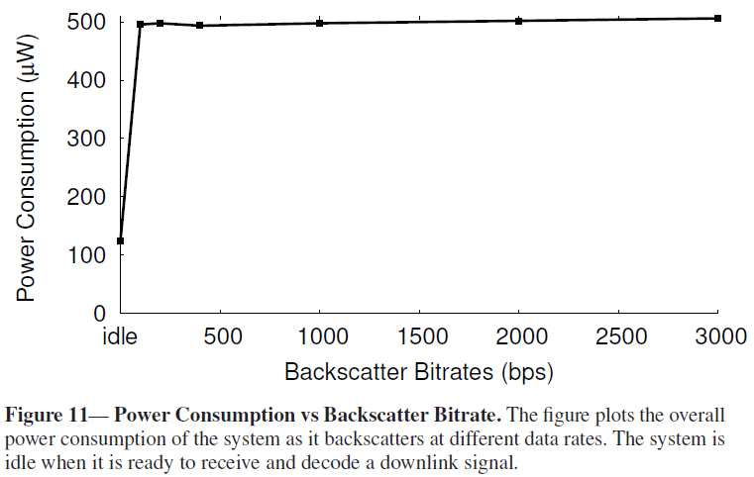
Evaluation
Power consumption
PAB only consumes 500$μ$W.
Notes:
Dielectric polarization

Slide 25
Evaluation
Power consumption
PAB only consumes 500$μ$W.
Notes:
Dielectric polarization

Slide 26
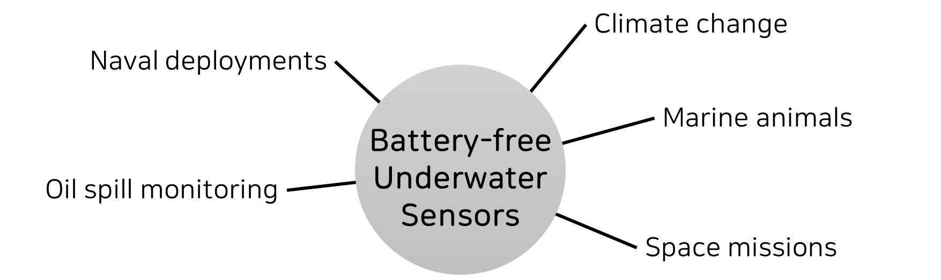
Applications
“Finally, we show how a PAB sensor can be used to measure pH, temperature, and pressure.”
Notes:
Dielectric polarization

Slide 27
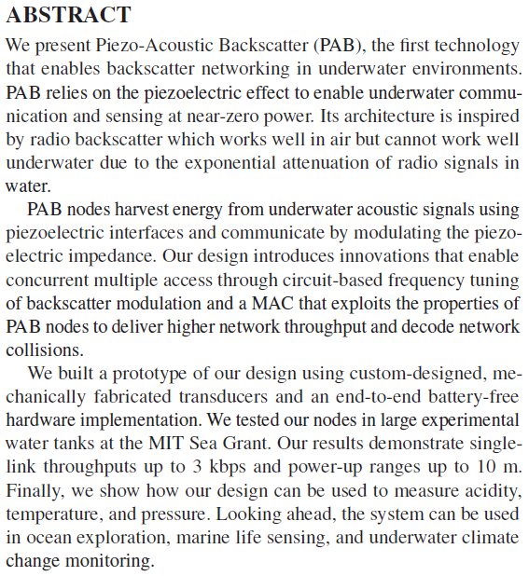
Summary
What is PAB?
What is the principle of PAB?
How does PAB work?
Can it work concurrently?
Does it work well?
Where can we use it?
Notes:
Dielectric polarization

Slide 28
Opportunities
Testing in more complex environment such as rivers, lakes, and oceans
Increasing number of channels
Increasing range and throughput
Notes:
Dielectric polarization

Slide 29
My concerns
Testing in more complex environment such as rivers, lakes, and oceans
Increasing number of channels
Increasing range and throughput
What if signal is obstructed?
What happens if there is a dolphin(?) near by?
Security issue.. (Easily hackable/corruptible)
Self interference?
“Power-up ranges up to 10m”? I don’t think so…
Enable underwater – onground communication!
Notes:
Dielectric polarization

Slide 30
Any Ideas?
Thank You

